Slide 1
L4/5 GROUP 11
Thomas wenman
Jordan marks
Mark key

Slide 2
LOGLINE, Target audience and genre
Logline: After experiencing an all night party for the first time. Lily will have to find her friends missing items.
Target audience: 18+ year olds.
Genre: Point and click.
Platform: PC
Notes:
Tom

Slide 3
Monachopsis
“The subtle but persistent feeling of being out of place.”
Notes:
Jordan

Slide 4
Rückkehrunruhe
“The feeling of returning home after an immersive trip only to find it fading rapidly from your awareness. ”
Notes:
Tom

Slide 5
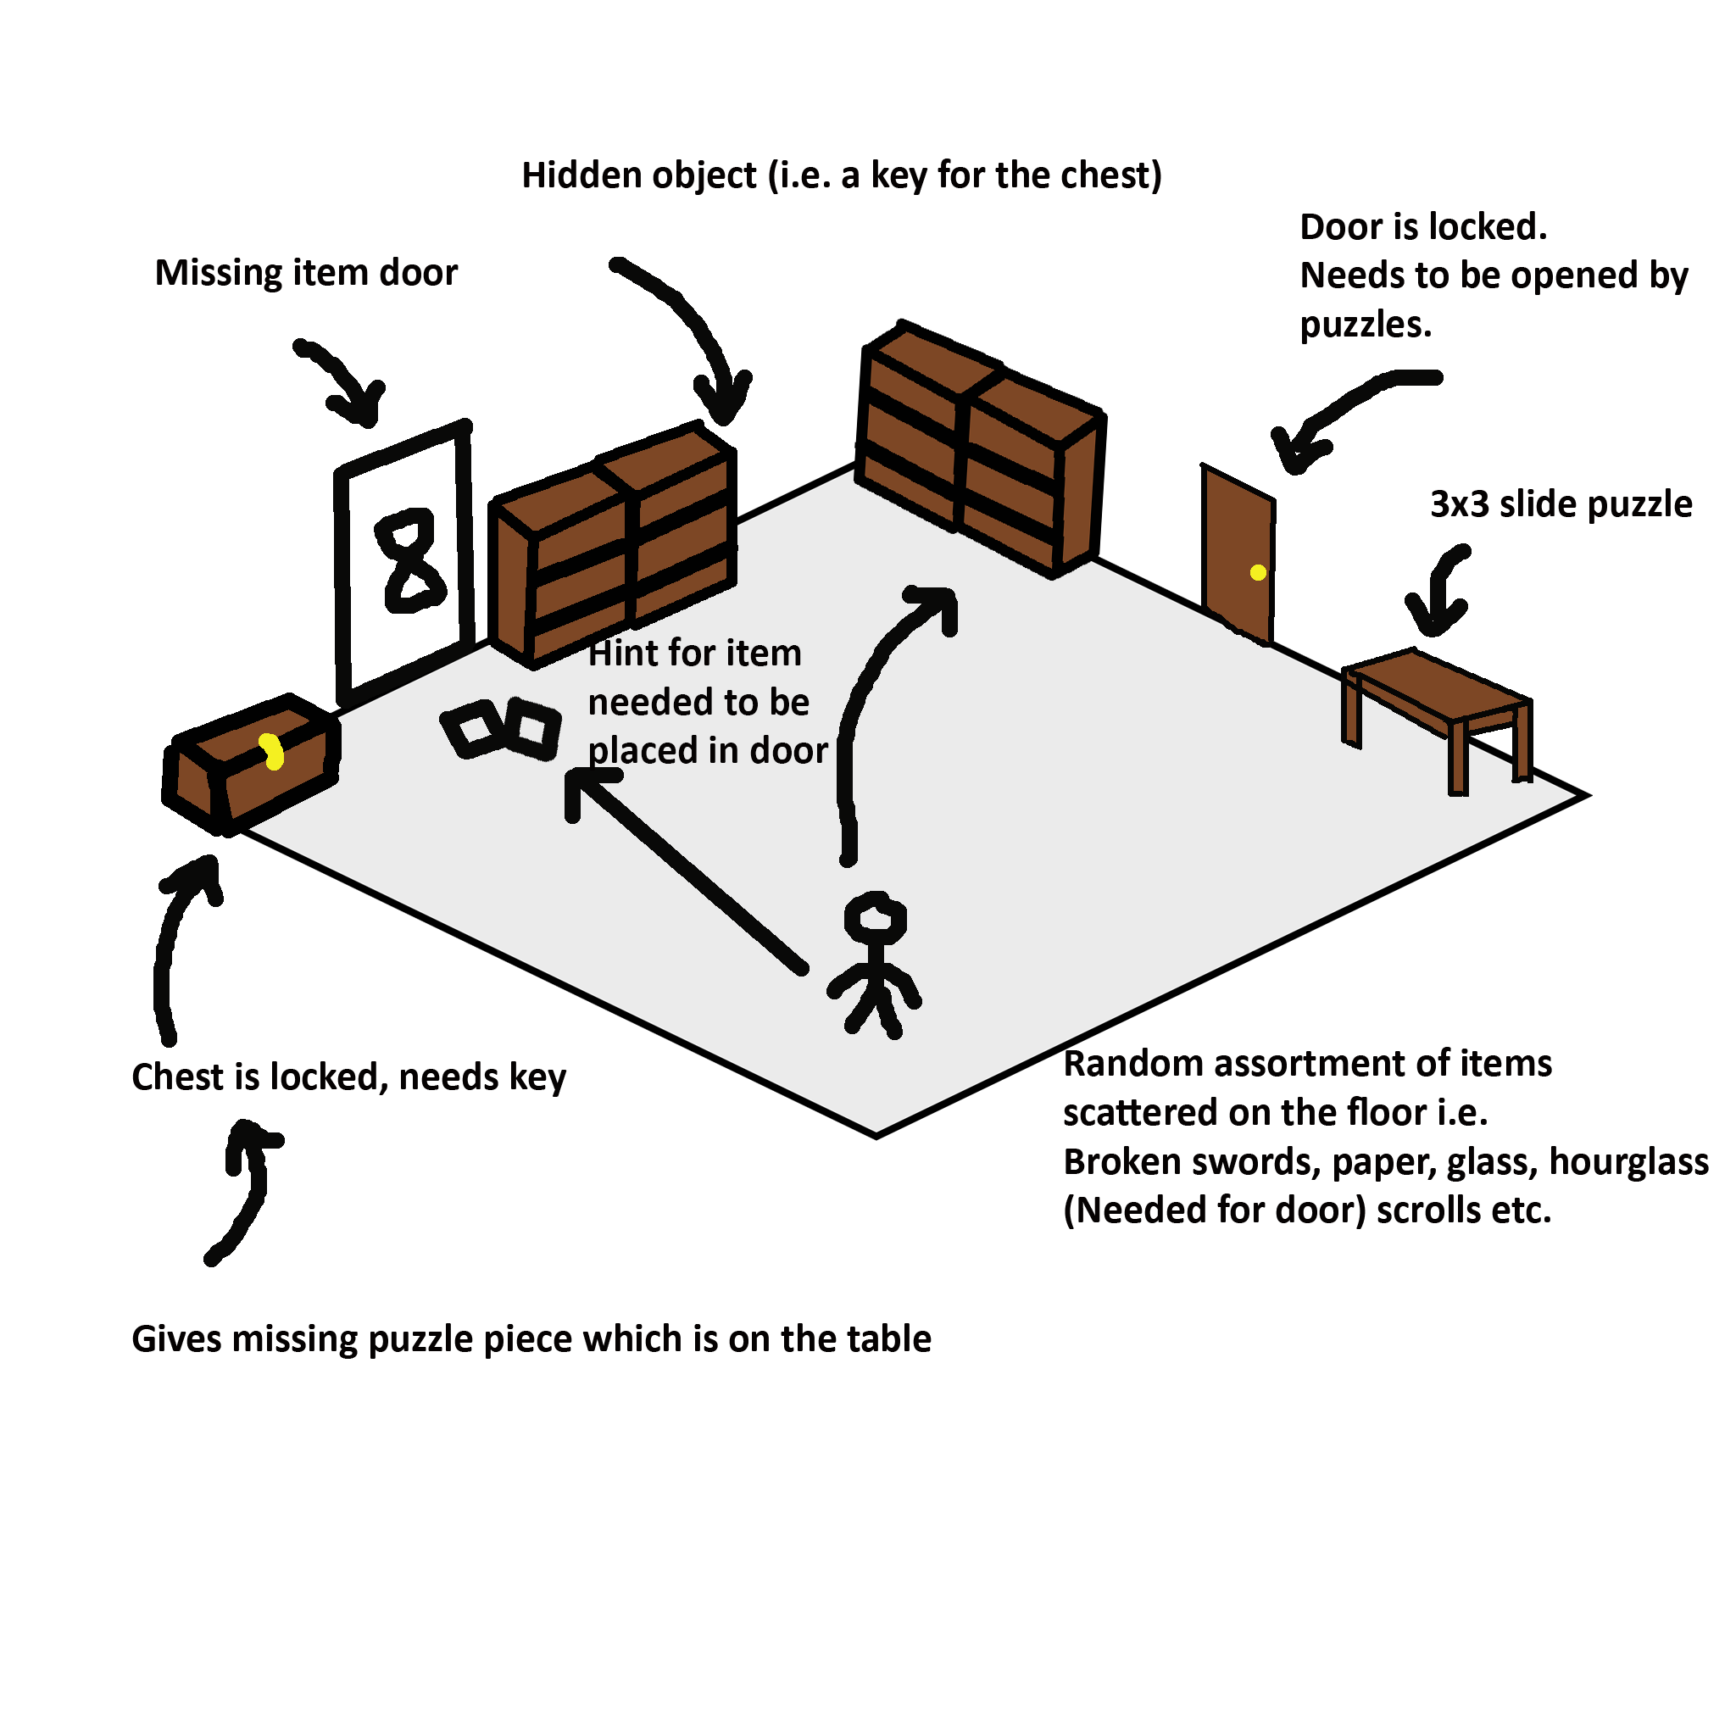
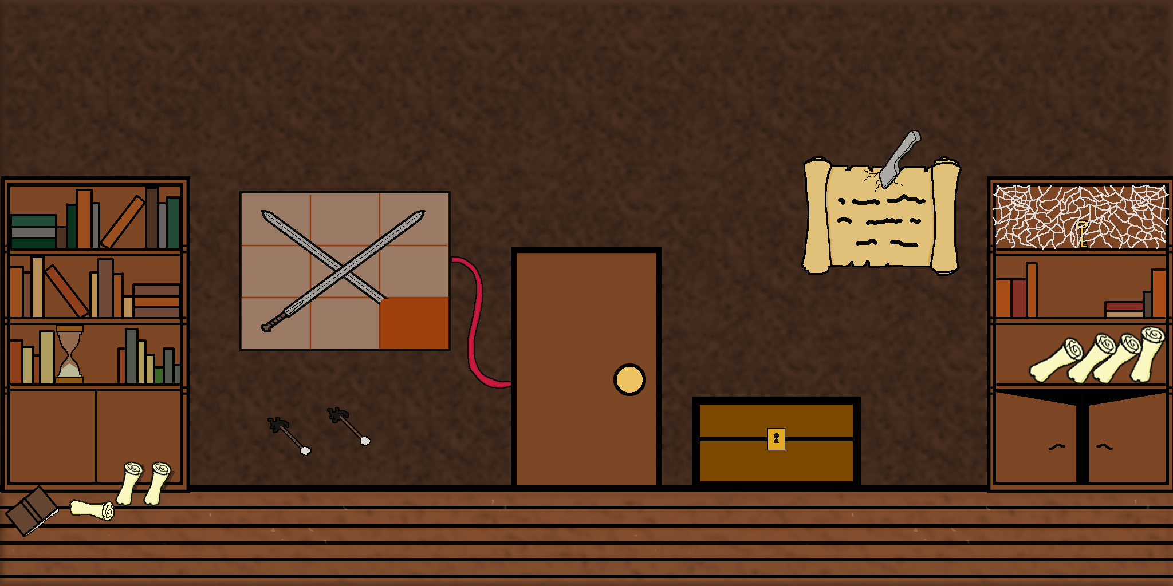
The iterations throughout the sprints
Notes:
Both

Slide 6

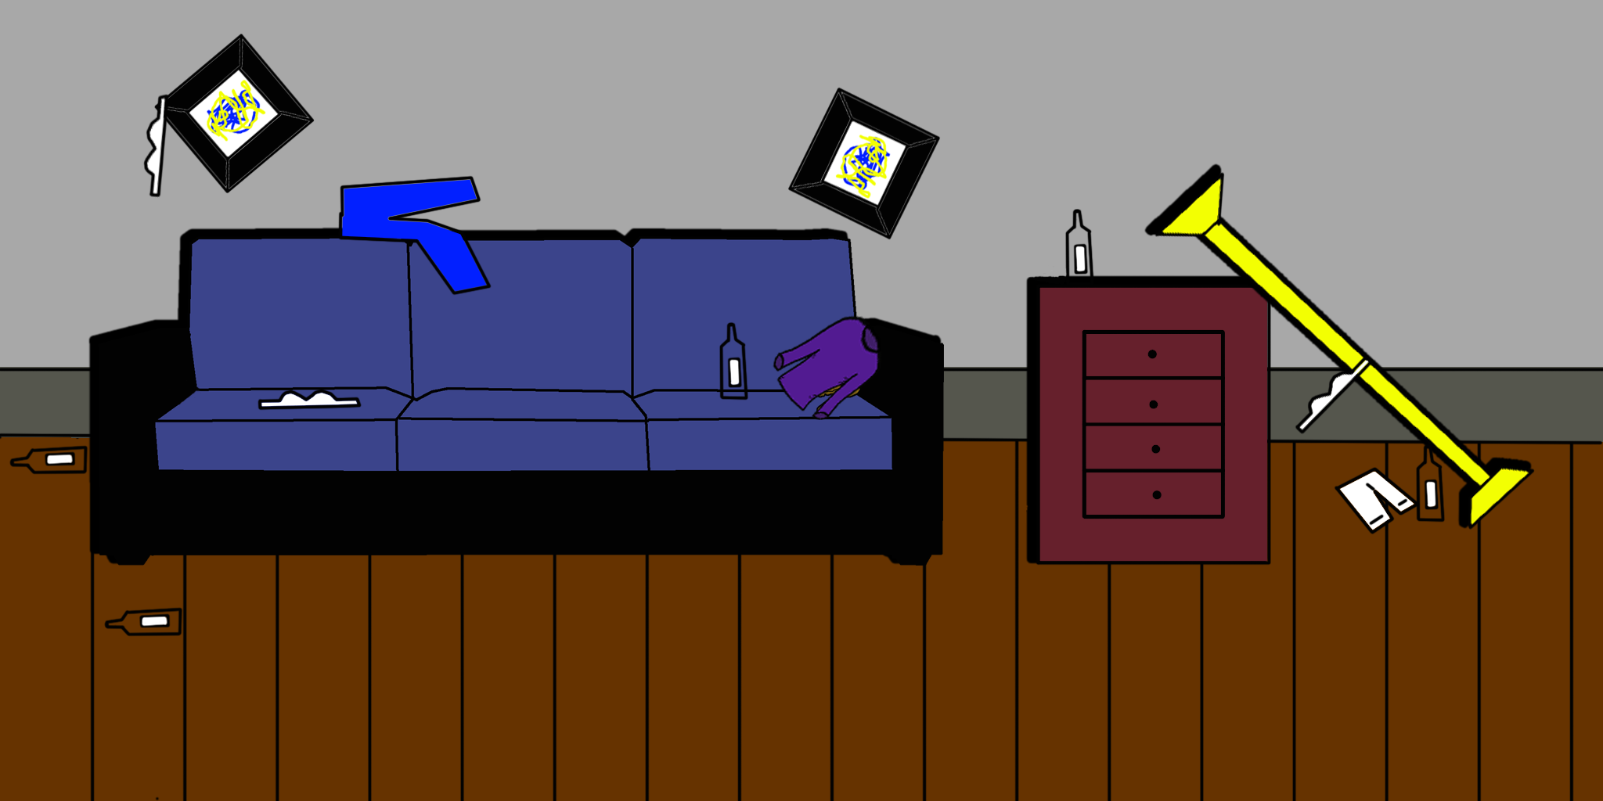
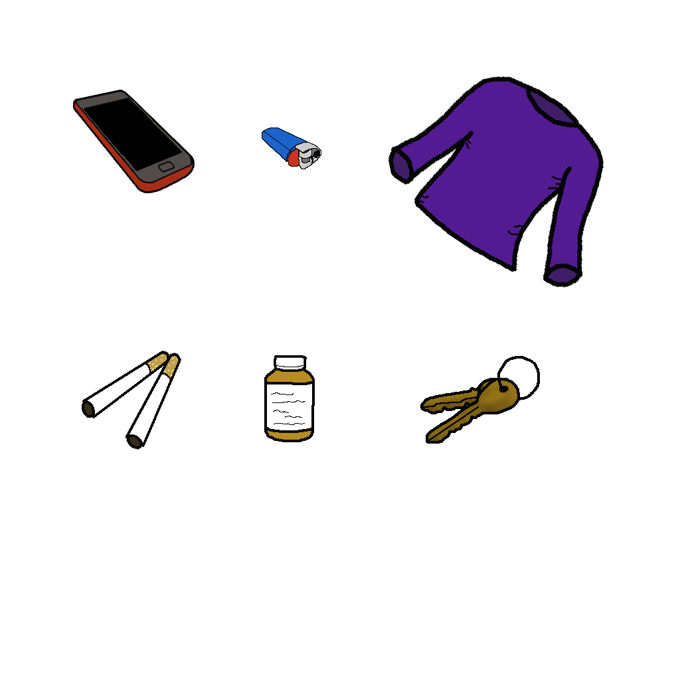
Artwork
Notes:
Jordan

Slide 7
Prototype
Notes:
Tom

Slide 8
Future plans
Fix code
Next Room
Notes:
Both

Slide 9
Upload days
Notes:
Both

Slide 10
management
Work done: Mark 0 hours done, Tom 30 hours done and Jordan 26 hours
Emails: Mark 1 emails, Tom 36 emails and Jordan 27
Notes:
Both

Slide 11
Questions?

